Slide 1
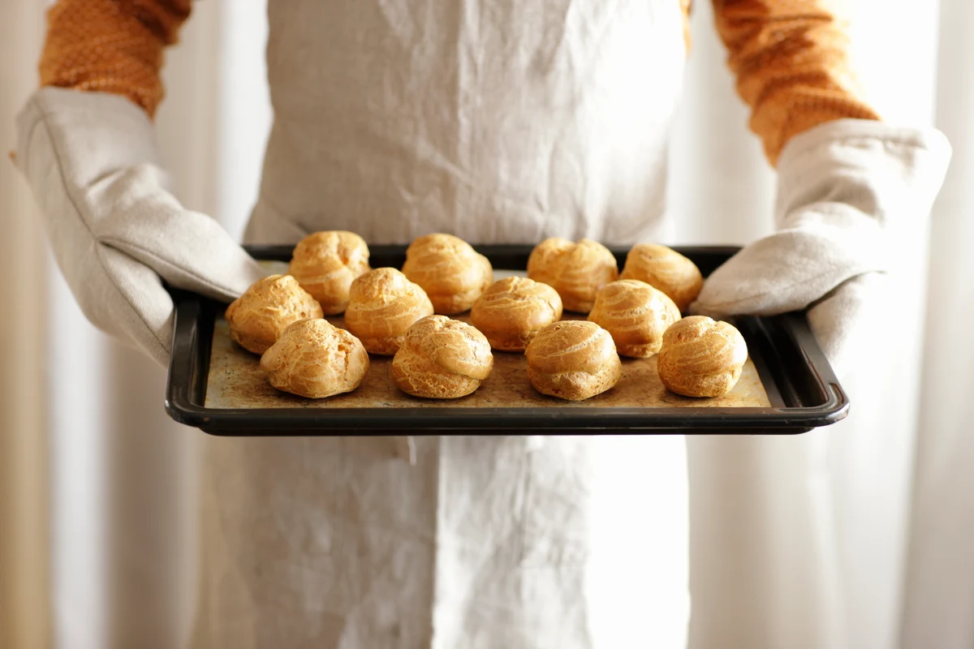
Wilmington Bakers Business Improvement Plan
Final Review

Slide 2





THE TEAM
April Cardella
Project Manager
David Capo
ABC Analysis Analyst
Katerina Watson
Dashboard & Price Optimization Analyst
Zach Petrea
Dashboard & Price Optimization Analyst

Slide 3


OUR SPECIALIZED OFFERINGS
Sales Analysis
Price Optimization
Labor & Operation Cost Analysis
Notes:
This came about because the Bakery expressed interest in bettering their business practices by utilizing data analytics.

Slide 4

PROBLEM STATEMENT
The Wilmington Bakers want to use data analytics to make smarter business decisions. Currently the challenges lie in assessing product performance, establishing optimal pricing strategies, and how to align operating hours with sales patterns to reduce labor costs.
After our analysis, the bakery will understand how holidays affect their sales and how price changes have influenced customer purchases. Our team will aid in the discovery of utilizing data analytics to reach a profitable solution.
Our team will utilize the Wilmington Baker's sales data to conduct an ABC analysis. The findings of that analysis will indicate to us which products are most popular with customers and which are not. Alternatively, the lowest performing products could be maximized by a promotional sales price.
From the analysis, guidance will be provided through price optimization by reviewing price fluctuations to achieve optimal profits and customer retention.
Through the review of customer traffic data across different time periods, our team will provide insights on how to best adjust for seasonal demand to decrease extraneous labor expenses.
Finally, we built a dashboard that consolidates our findings and recommends the products Wilmington Baker's should have on display to lead to higher profit margins. Ultimately, our goal is to help the Wilmington Baker's whisk up informed decisions that will keep them rising in success for years to come.

Slide 5

Wilmington Bakers ABC Analysis
Group 5
BAN-530

Slide 6
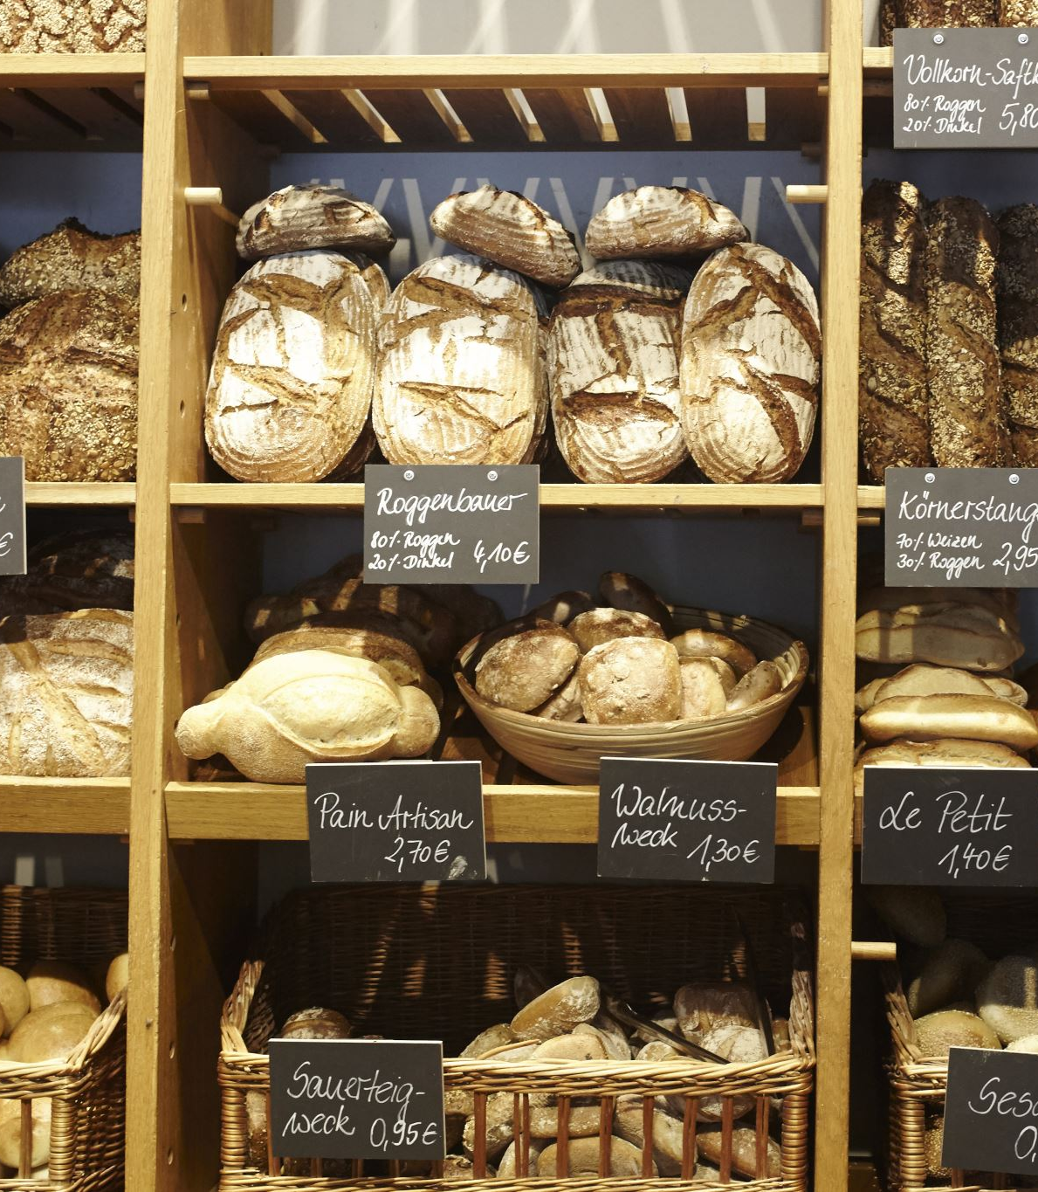
Data Overview
The Wilmington Bakers sales dataset has six columns:
Date: the date of the transactions.
Time: the time of the transactions.
Category: the category of product sold.
Sub-Category: the more granular type of product sold.
Price: the price the product was sold for.
Sales Volume: the quantity of product sold.
This ABC analysis primarily focuses on Sales Volume, which we then multiply by Price to calculate Revenue. Revenue and Volume are used to classify the products for specific service levels that will help us determine safety stock and reorder points for each product.

Slide 7
Inventory Classification Methodology
Why are we doing this?
ABC classification helps in identifying top-performing and underperforming items.
Aids in strategic decision-making for inventory management (safety stock, reorder point).
Process Details:
Revenue Rank and Volume Rank are calculated for each sub-category.
A combined score is derived from these ranks.
Products are classified into categories based on the combined score.
This ensures a balanced view of inventory based on both revenue generation and popularity.
Classification Criteria:
Based on combined analysis of revenue and sales volume.
Products are ranked according to their performance in revenue and sales volume.

Slide 8
Inventory Classification Details
The classification categories for Revenue, Volume, and the Combined Ranking were A, B, and C, with A being the best and C being the worst. The groups were assigned based on cumulative percentage of total, values descending, on the scale below:
Then, the Combined Ranking was calculated by combining the Revenue (65%) and Volume (35%) ranks:
Note: A = 3, B = 2, C = 1

Slide 9
Revenue Ranking Sample
Revenue ranks are broken into A, B, and C.
Just 4 sub-categories make up the A revenue ranking.
Above is a snapshot of the data table where the ranking was done at the product sub-category level.
Éclair leads at 30% of cumulative sales.

Slide 10
Volume Ranking Sample
Volume ranks are also A, B, and C
Most hits captured by only 5 sub-categories
Like revenue, we have a snapshot of the table where the ranking was done.
Éclair leads with 34% of volume, top product sub-category for Wilmington Bakers.

Slide 11
Combined Ranking
Combined ranking calculated by merging revenue (65%) and volume (35%) rankings
A = 3, B = 2, C = 1 methodology
Final ranking pulls revenue and volume numerical ranks for each SKU
Combined rank calculated by weighting the values
Ranks assigned based on weight range

Slide 12
Safety Stock & Reorder Point
Using the combined ranking, we assigned a service level to each final rank. The service levels are determined based on the criticality of maintaining stock for each rank to ensure high product availability and customer satisfaction.
For C items, the plan is to sell through them ASAP with a promo but keep them stocked at a low service level of 70%.

Slide 13
Safety Stock & Reorder Point Sample
Above is a sample of the safety stock and reorder point analysis, showcasing each combined ranking. As you can see, A has the highest safety stock while C has little to none.
The reorder point is calculated based on safety stock and average demand over lead time. We assumed 1 day for the lead time because baked goods are perishable and made-to-order, so it’s more of a point-in-time look at what should be on hand.
For example, when Éclair inventory hits 126 units, more should be baked, maintaining a safety stock of 81 units.

Slide 14
Summary
Implementing ABC classification at Wilmington Baker's will streamline inventory management by focusing on high-demand items like éclairs, cannoli, and muffins.
This will ensure optimal stock levels and reduce holding costs. For low-demand items, we plan to minimize stock, promoting quick sell-through to boost turnover.
Prioritizing inventory based on revenue and volume will support business goals and improve customer satisfaction.

Slide 15

Dynamic Dashboard
Group 5
BAN-530
Notes:
Kate

Slide 16
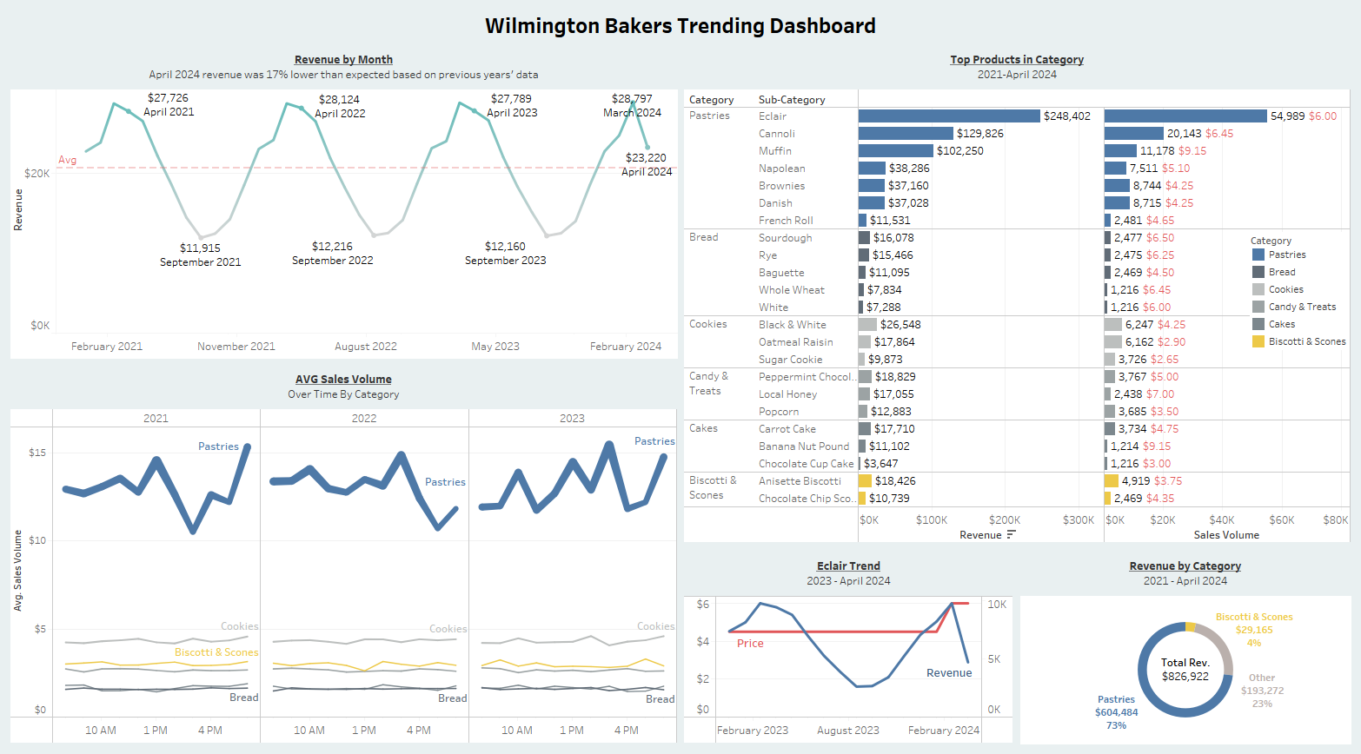
Notes:
Kate
Talk about most important items on dashboard
Discuss legend

Slide 17
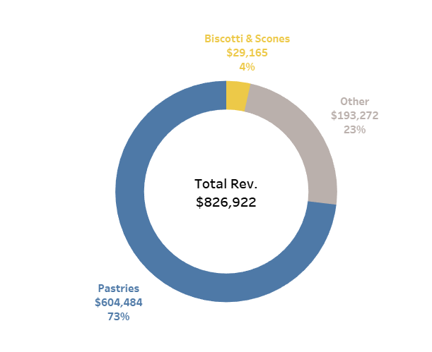

Revenue by Category
2021 - April 2024 Pastries is by far the largest category of revenue making up 73% of the revenue for Wilmington Bakers while Biscotti & Scones make up the smallest portion of the revenue at 4%
Notes:
Kate

Slide 18
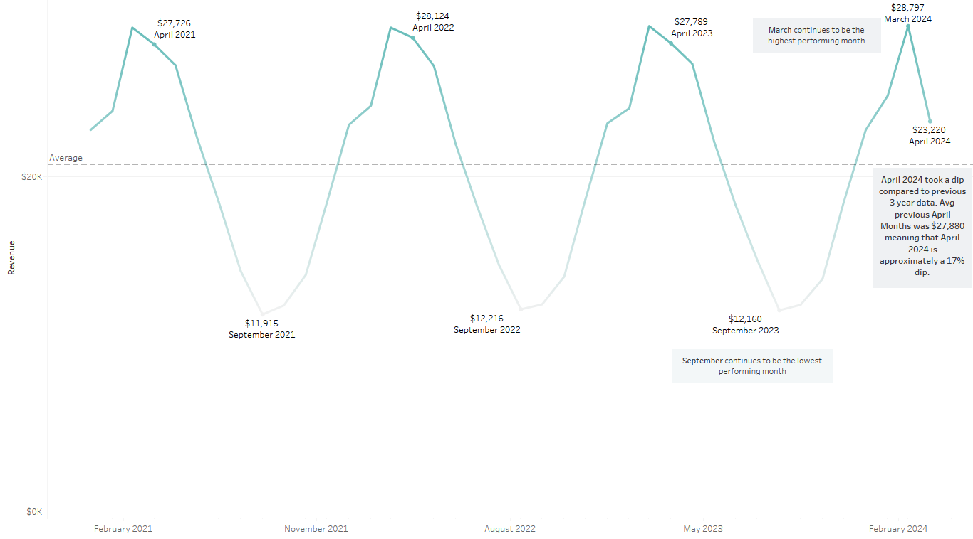

Wilmington Bakers Revenue by Month
April 2024 revenue was 17% lower than expected based on previous years' data
Notes:
Kate
Jan – June are always above average

Slide 19
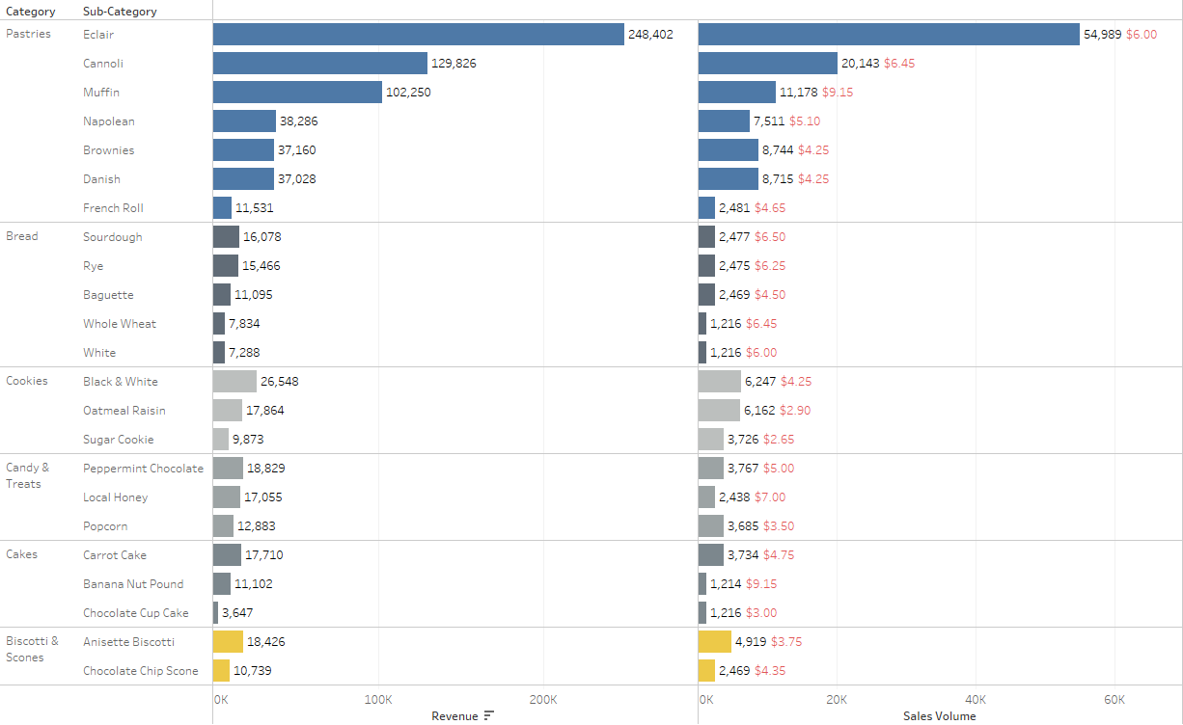
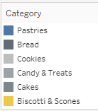

Top Products in Category
2021 - April 2024 Recommend promoting Biscotti and Scones, removing Category or adding to product Additional recommendation to increase price on subcategories that sell a lot, but price is too low Example: If price of Carrot Cake was $5.25 (11% increase), during this time, would have made ~$1,800 more. Carrot Cake accounts for 60% of all cakes sold but it is priced 48% less than Pound Cake
Notes:
Zach

Slide 20
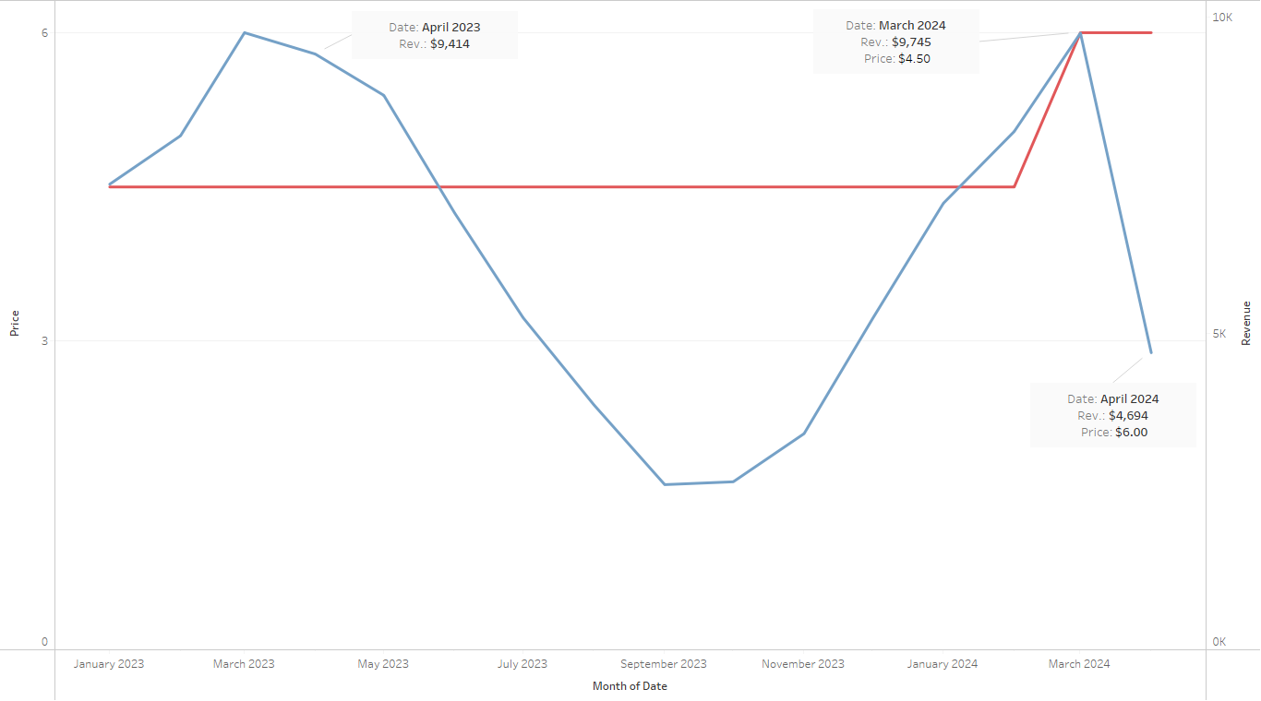

Eclair Trend 2023 - April 2024
Eclairs are the top selling product in the top selling category of Pastries Eclairs are sensitive to price changes
Notes:
Zach

Slide 21
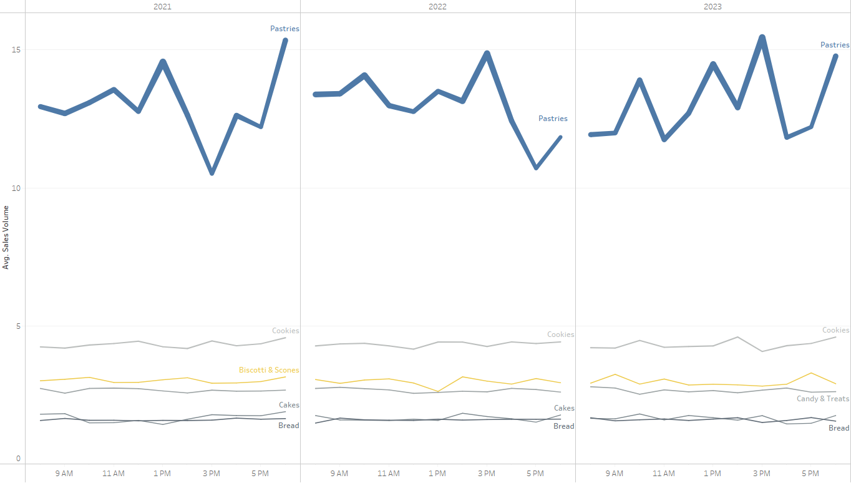

Average Sales Volume 2021 - 2023
Pastries seem to have volatility in Average Sales Volume during certain hours All other categories seem to stay consistent
Notes:
Zach

Slide 22
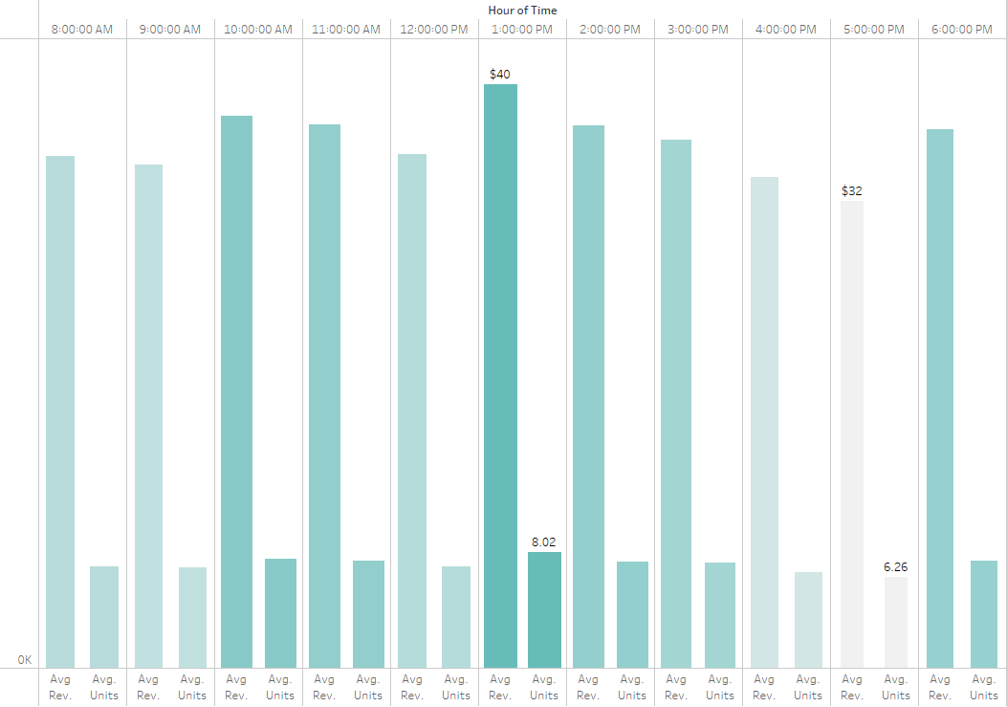

Peak Hours Busy Season January - June 1 PM is the peak time for units sold and revenue for Wilmington Bakers
5PM is the time with the least revenue and units sold
Notes:
Kate

Slide 23
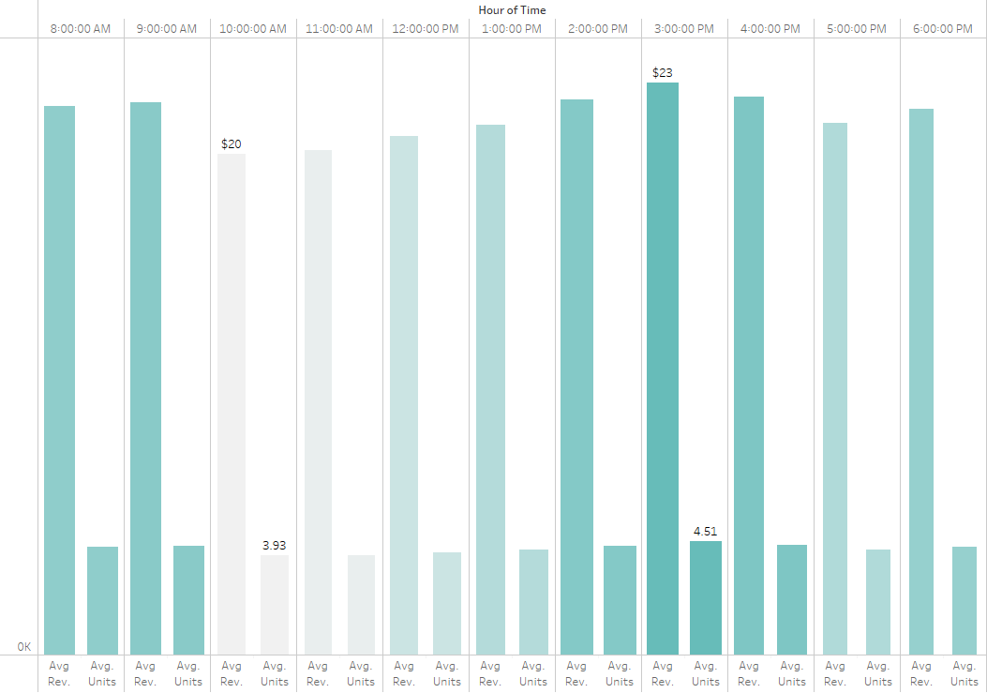

Peak Hours Slow Season July - December
3 PM is the peak time for units sold and revenue for Wilmington Bakers
10AM is the time with the least revenue and units sold
Notes:
Kate

Slide 24


Dynamic Dashboard Findings
March is consistently the month with the highest Revenue while September has the lowest revenue
Customers are sensitive to price changes of most popular products, April 2024 performed poorly compared to previous years
Customers did not like the 33% price increae for Eclairs
Revenue down 17% for April 2024 compared to previous April months
There is a pattern to high traffic months and low traffic months, understanding peak hours in a particular season can help with overstaffing
January - June is busy season
July – December is slow season
Consider price increases for low-cost product which performs well and a smaller price change 10%-25%
School Schedules, Holidays and other notable events could have an impact on peak months
Practice price adjustments on less popular products to test customer insterest
Potential to remove low selling categories from the menu if they take a lot of labor, time and ingredients to complete or run a promotion to help sell
Biscotti and Scones are low priced but do not sell as well
Adding new items could help with the Category
Notes:
Kate to run through first 3 and Zach to discuss last 2

Slide 25
Price Optimization
Group 5
BAN-530
Notes:
Zach

Slide 26
Steps for Price Optimization – using R Studio
Cleaned data
Formatting time, date and standardizing formats
Reviewed any missing values
Exploratory Analysis
Summary Statistics
Correlation between values
Linear Regression Model Chosen (repeated for each independent variable)
Fit best for the given data (continuous time, not many categories)
Trained model using price as the dependent variable based on the remaining independent variables, such as sub-categories
Created predictions based on training data
Optimization algorithm
Evaluation of Results
Notes:
Zach

Slide 27
Suggested Price for Sub-Categories
Price optimization revealed the given prices in the chart to the right are the most optimal
Éclair optimal price is $4.30
Wilmington Bakers should not have increased price to $6
Optimal price is less than the peak revenue price of $4.50
Notes:
Zach

Slide 28
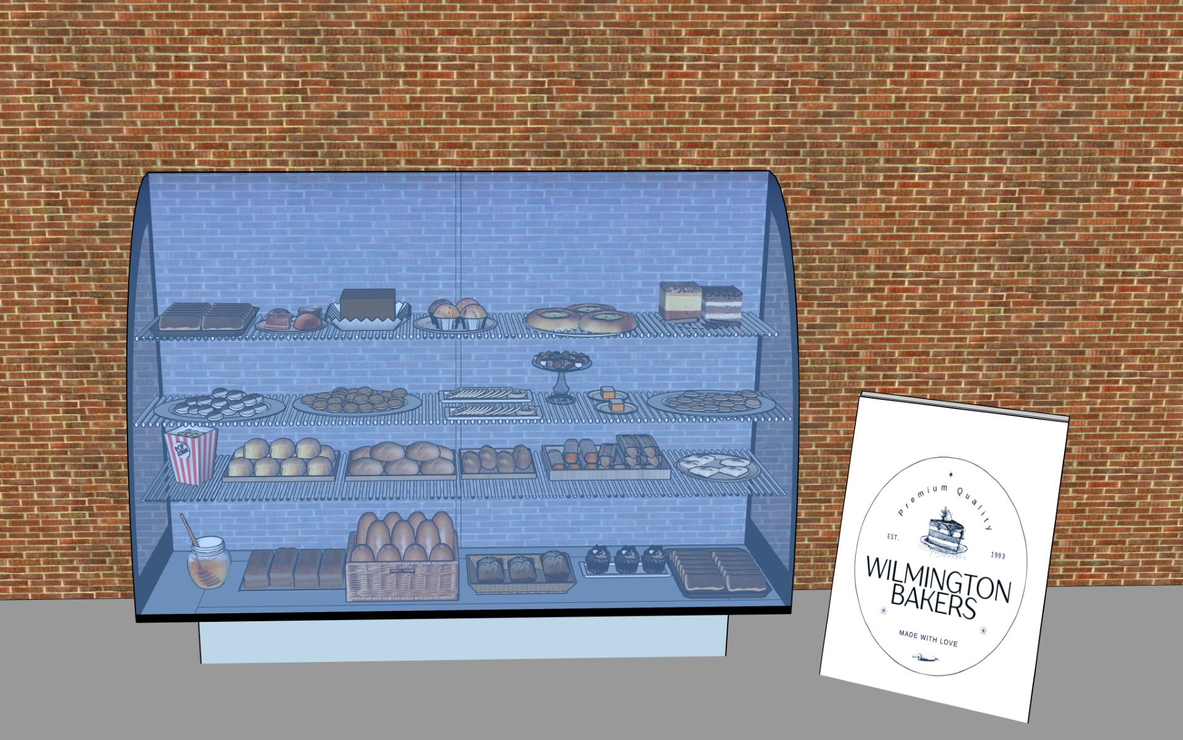
Display Case
The display case prioritizes products by sales volume
Starting with Éclair at the top left
We also placed Éclair at the bottom right, so it is displayed twice
Notes:
Everyone to talk about – maybe talk about their favorite dessert and how many of those favorites the bakery sells.
Zach – Black and white cookies
Katerina – Brownies
David - Éclair
April – Banana nut pound cake

Slide 29
Display Organization
Top of Display Case
Éclair | Cannoli | Muffin | Brownies | Danish | Napoleon
Black & White Cookies | Oatmeal Raisin | Biscotti | Peppermint Chocolate | Carrot Cake | Sugar Cookie
Popcorn | French Roll | Sourdough | Rye | Baguette | Chocolate Chip Scone
Local Honey | Chocolate Cupcake | White Bread | Whole Wheat Bread | Banana Nut Pound Cake | Éclair
Top Row
Second Row
Third Row
Bottom Row

Slide 30
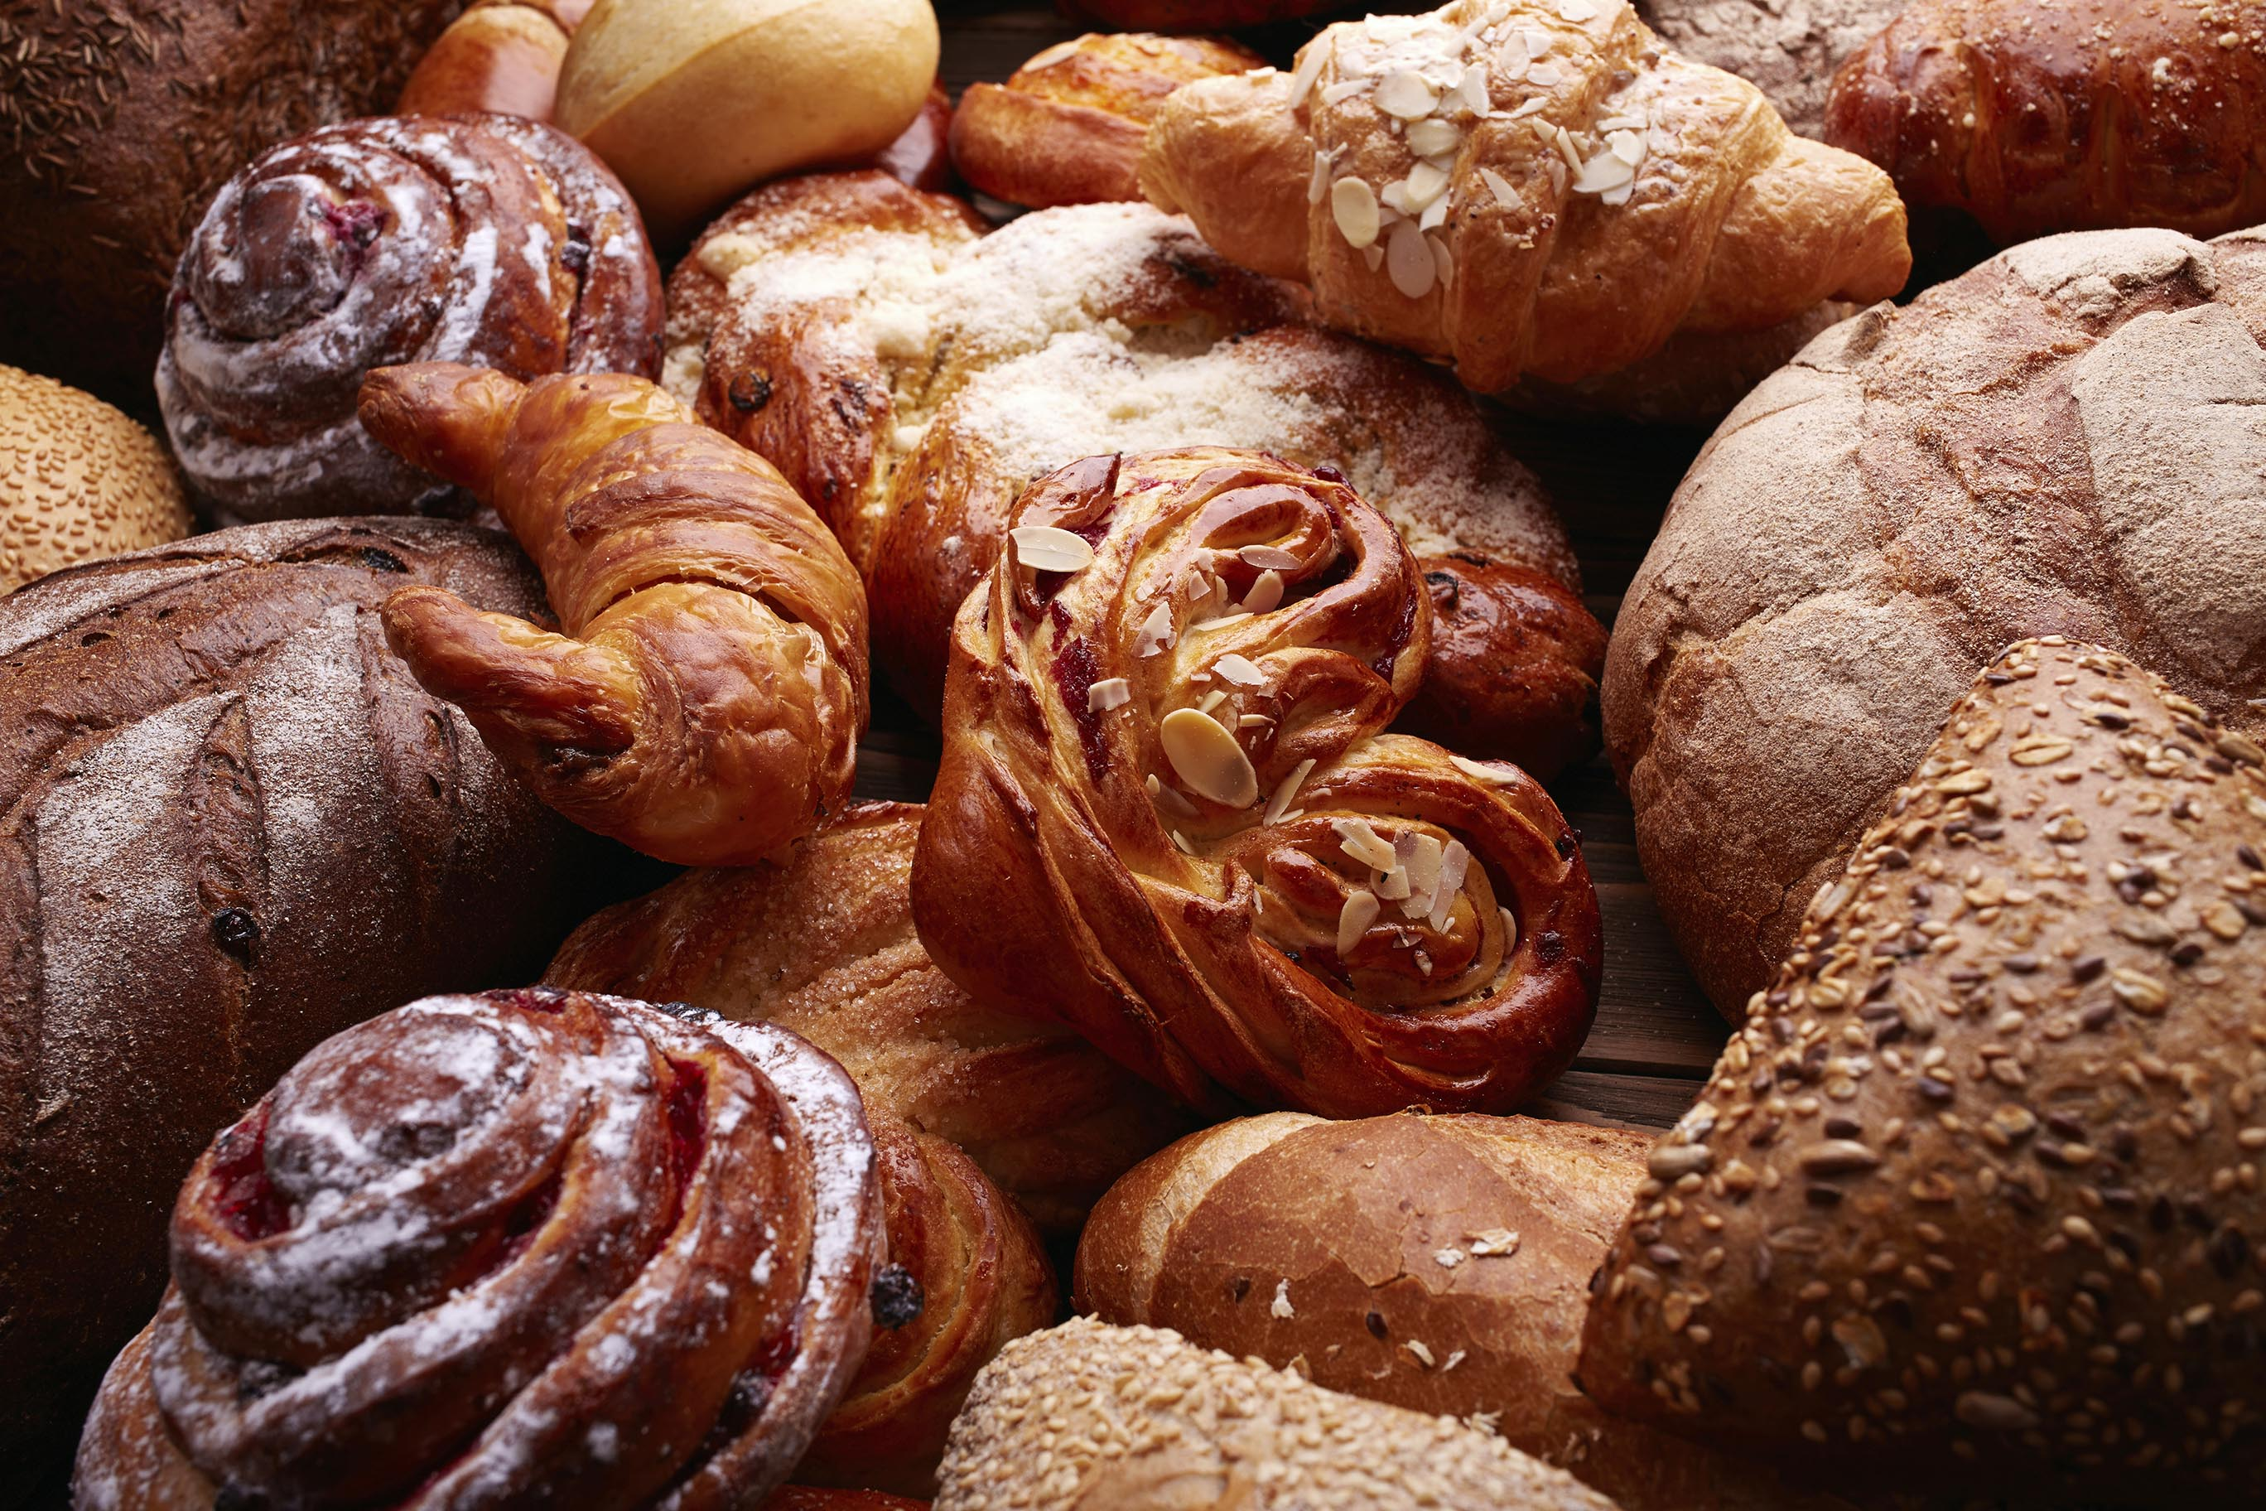
Thank you!
Notes:
In conclusion, we have discussed product, price optimization, ABC analysis, Labor cost analysis, a recommended layout for your display case as well as a interactive dashboard. Please reach out if you have any further questions.

